Slide 1

SWIGGY Sales Analysis
- Tableau
Presentation By
AKILAN J
DADS Oct Batch

Slide 2
Project Overview
Analyze sales trends by weekday and month.
Identify factors affecting cancellations & payments.
Assess city-wise performance for demand insights.
Support data-driven decisions for growth & efficiency.

Slide 3
Dataset Description
1) Dataset Overview
1,000 rows of mock food delivery data, designed to analyze sales trends, customer preferences, and payment behaviors for a platform similar to Swiggy.
2) Data Source
Generated using Mockaro, structured to reflect real-world food delivery data.
3) Key Features
Order Date & Time – Timestamp of order placement.
City – Delivery location.
Order Status – Delivered, Cancelled, etc.
Payment Method – UPI, COD, Credit Card, Debit Card.
Customer Satisfaction – High, Medium, Low ratings.

Slide 4
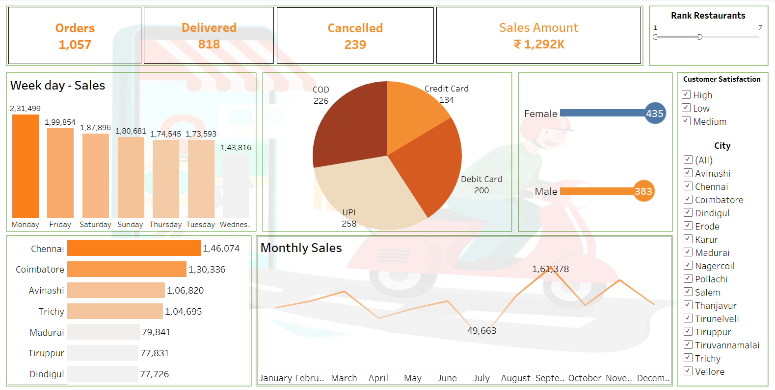
Dashboard

Slide 5
Key Insights/ Recommendation’s
Sale by Gender
Male sales are 25% less than female. Man prefer fast food, non-veg, and protein meals So, recommended to promote protein rich meals and combo deals to balance sales distribution
Focus should be given on Wednesday Thursday Provide – Discount’s, Zero delivery charges on cash on delivery to boost sales.
Provide discounts on digital payment on the restaurants facing max of cancelled orders
Introduce personalized recommendation Run social media ads Increase Restaurant’s Partnership
Top Performing City Chennai leads with Rs.146k in sales, followed by Coimbatore at Rs.136k
Cancelled Orders

Slide 6
Thank You

